Slide 1

Image search from Text

Slide 2
Image search with CLIP :
Image search task involves finding images from a collection that are most similar to given query, which is provided as textual descriptions in the form of text prompts.
CLIP(Contrastive Language-Image Pretraining):
CLIP is to enable a single model to understand and generate both natural language descriptions and visual representations.
CLIP is a novel framework introduced by OpenAI that leverages contrastive learning to jointly train a vision model and a language model.
Vision Model: This component processes images and generates embeddings (high- dimensional numerical representations) that capture visual information.
Language Model: This component processes textual descriptions and generates embeddings that capture semantic meaning.

Slide 3
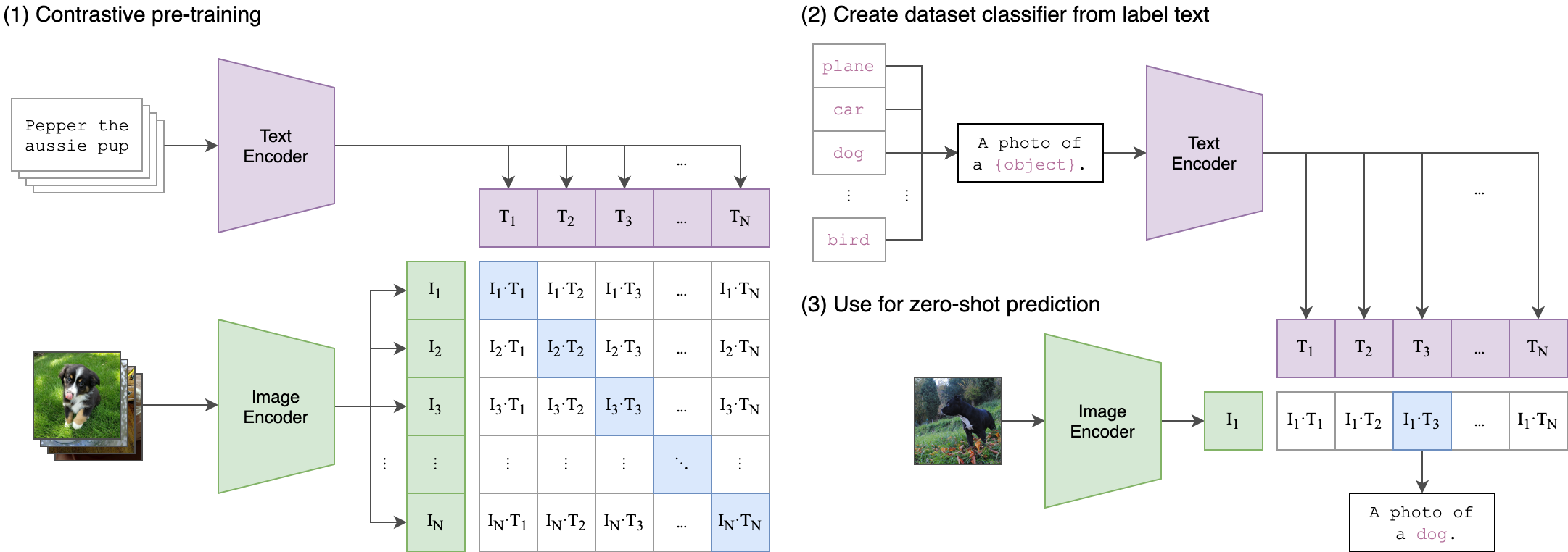

Slide 4
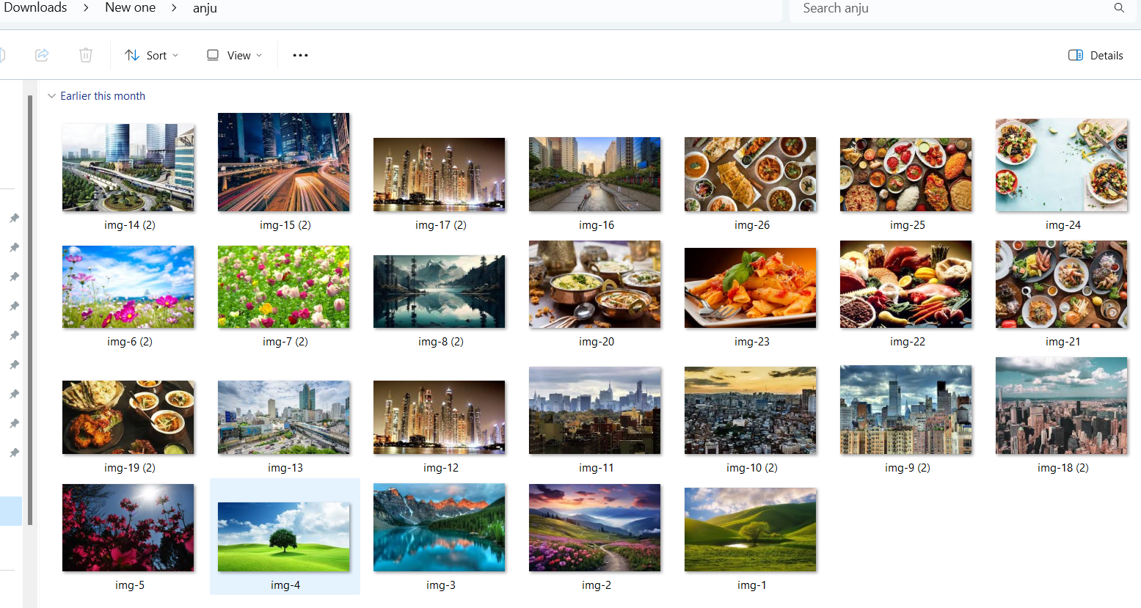
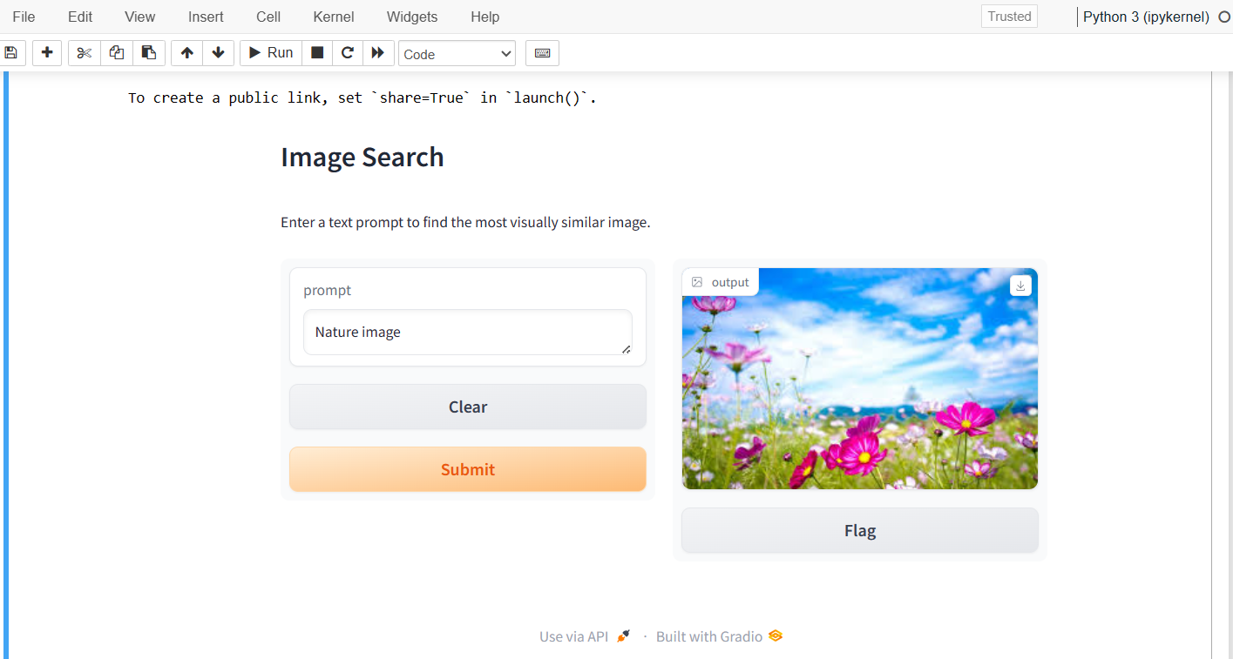
Input images folder
Output

Slide 5
Thank you

